Slide 1
Assignment 10: Decision Trees
Tania Ommer

Slide 2
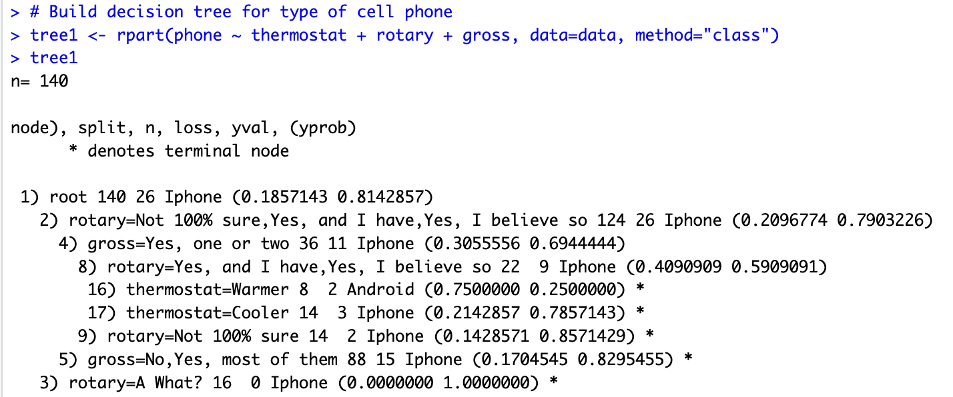
Tree 1: Type of Cell Phone
decision tree printed as text

Slide 3
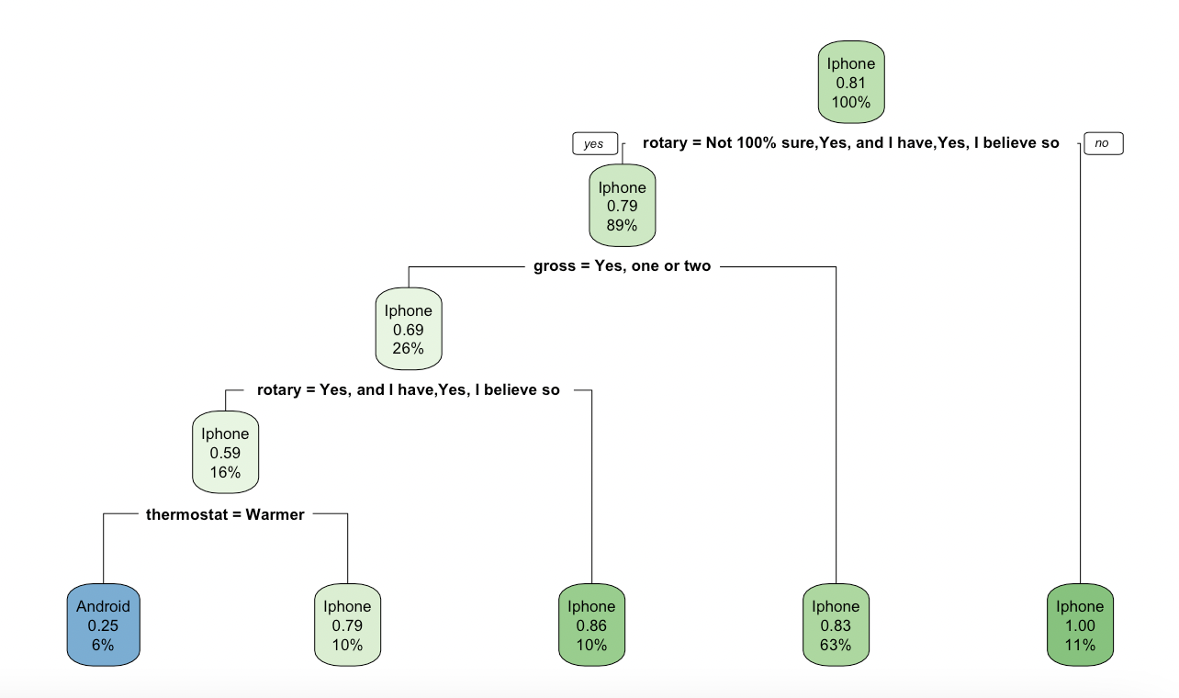
decision tree plotted

Slide 4
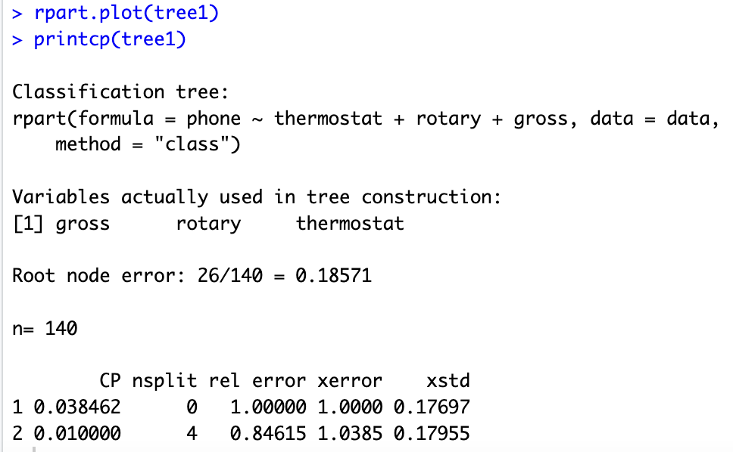
relative error:

Slide 5
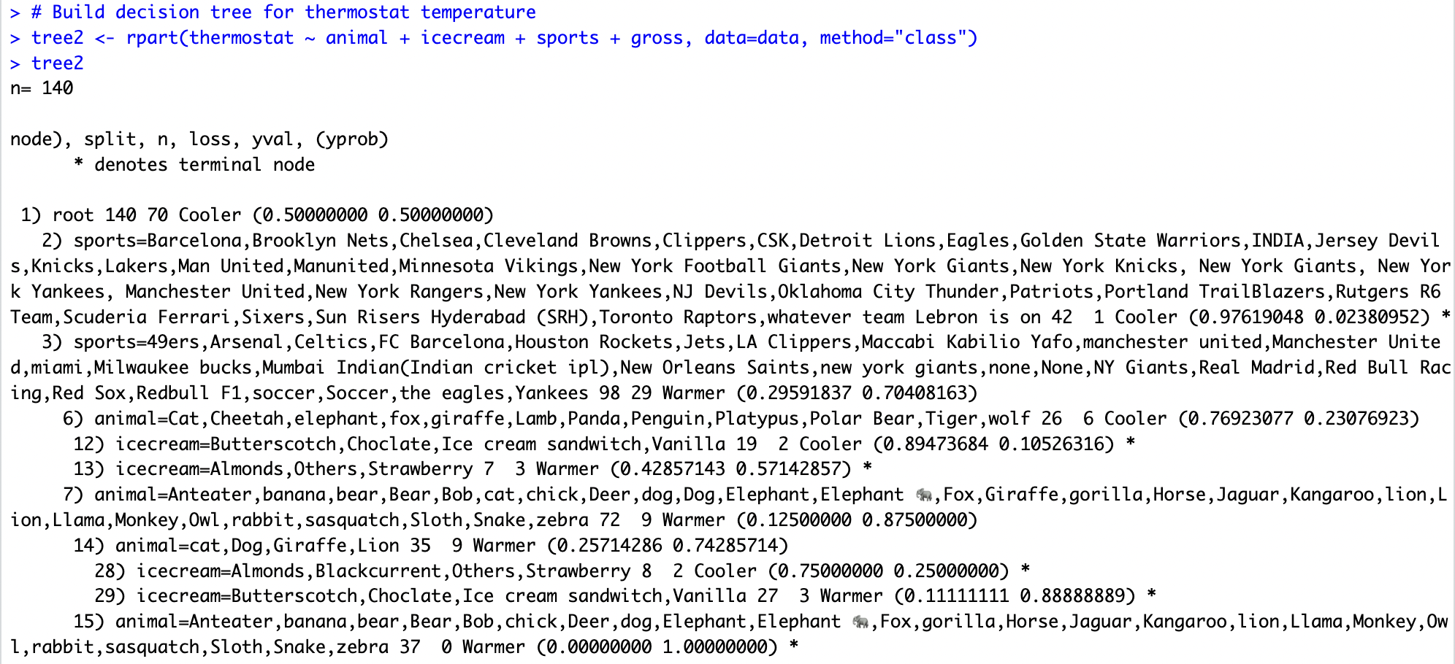
Tree 2: Thermostat Temperature
decision tree printed as text

Slide 6
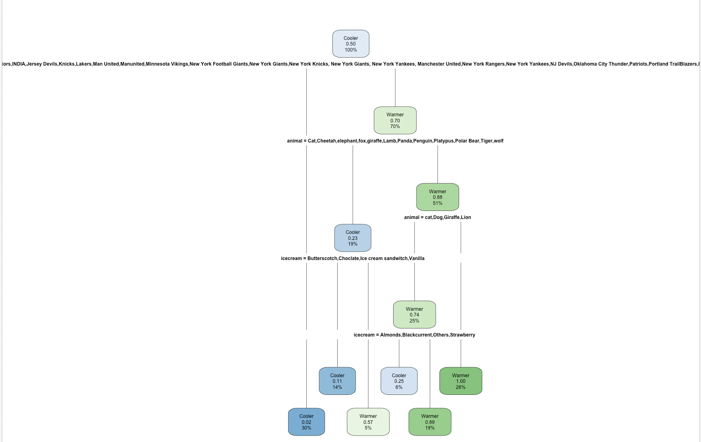
decision tree plotted

Slide 7
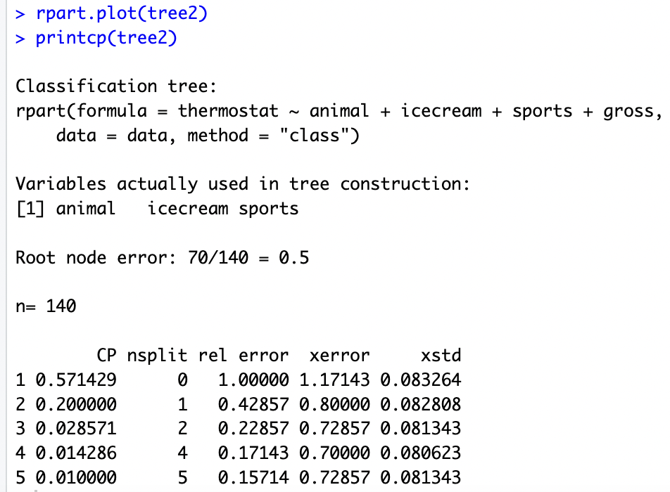
relative error:

Slide 8
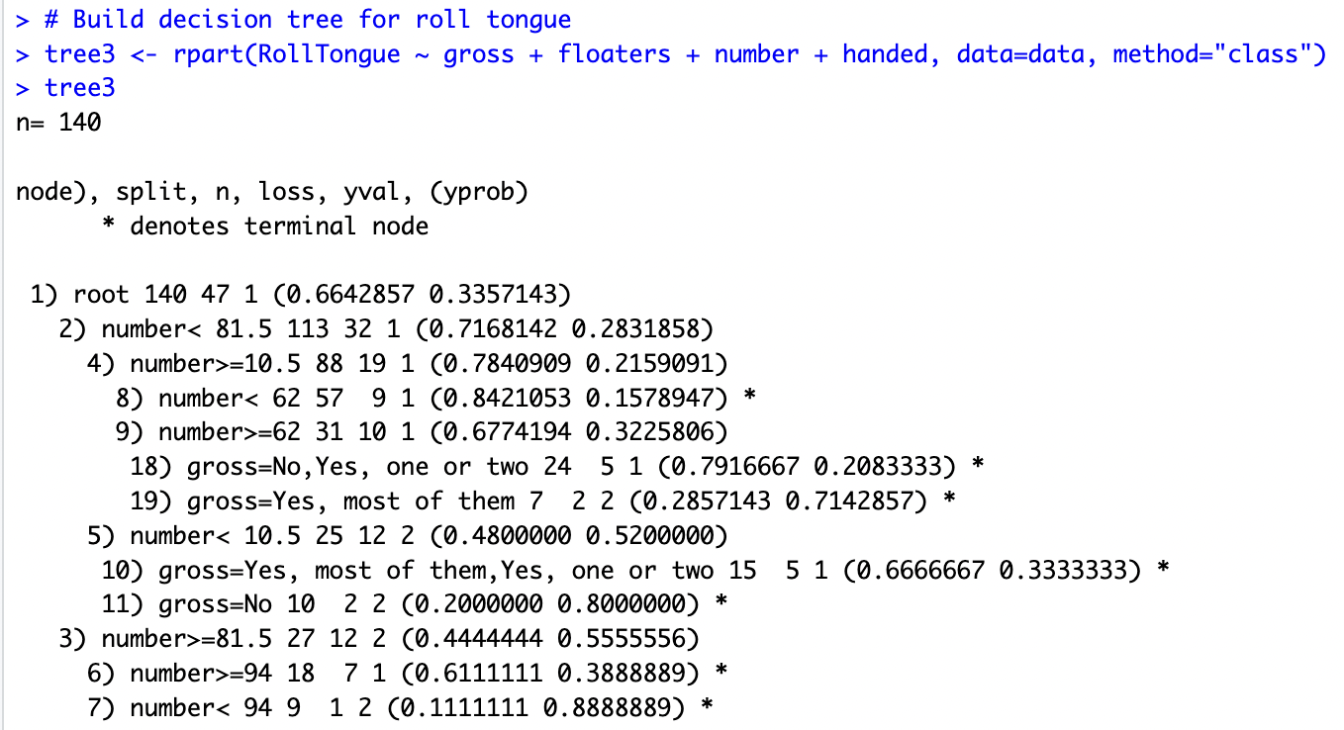
Tree 3: Can you roll your tongue?
decision tree printed as text

Slide 9
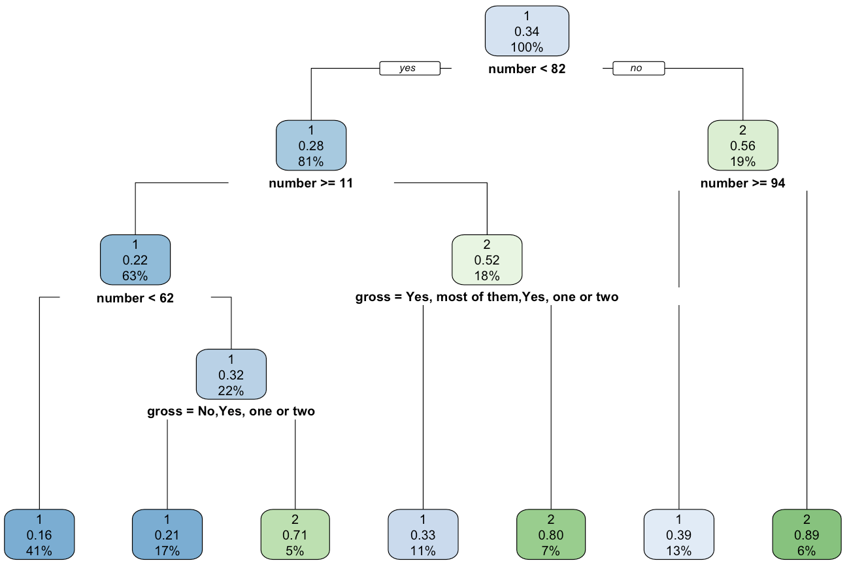
decision tree plotted

Slide 10
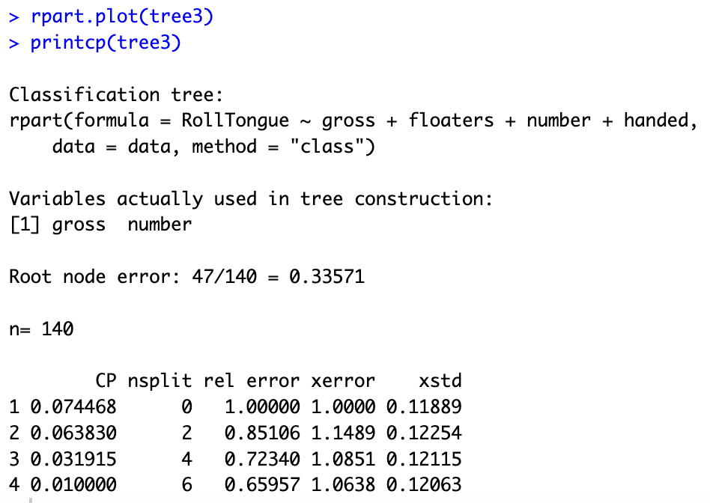
relative error:

